Slide 1
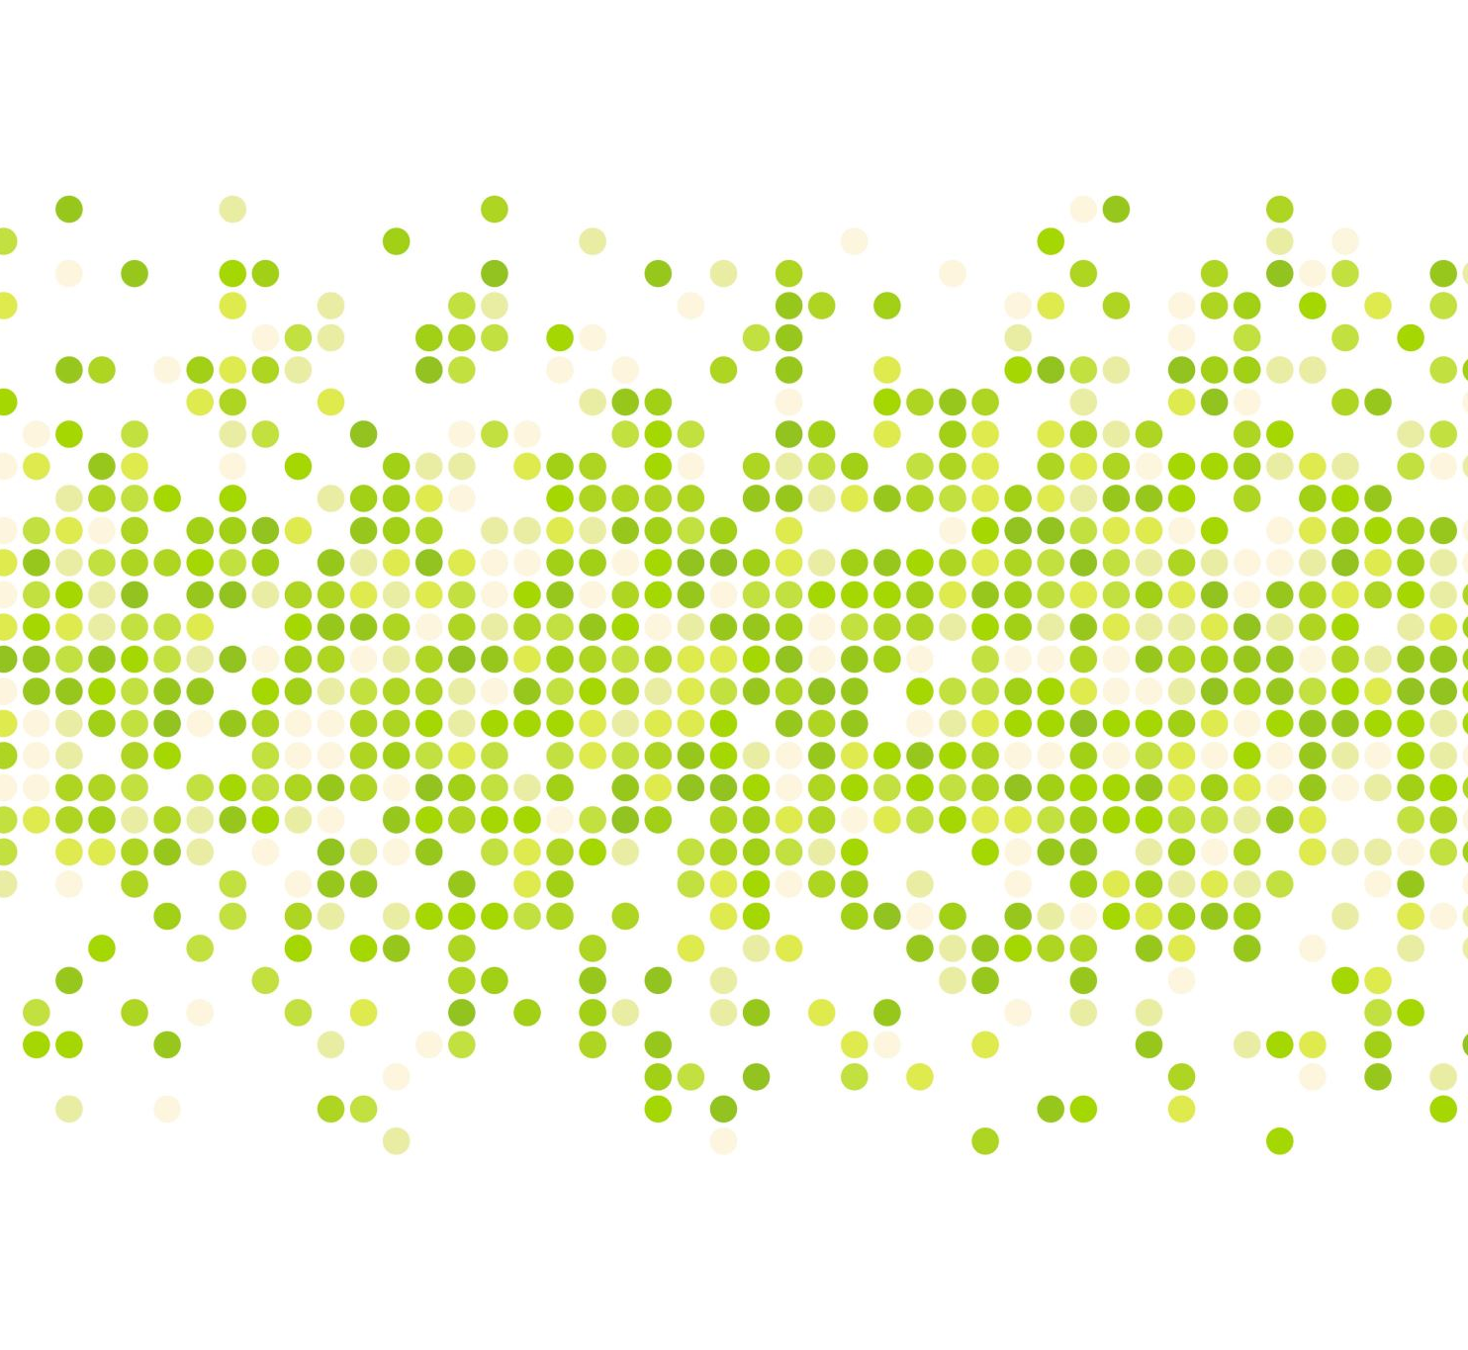

Quarkstack Overview

Slide 2
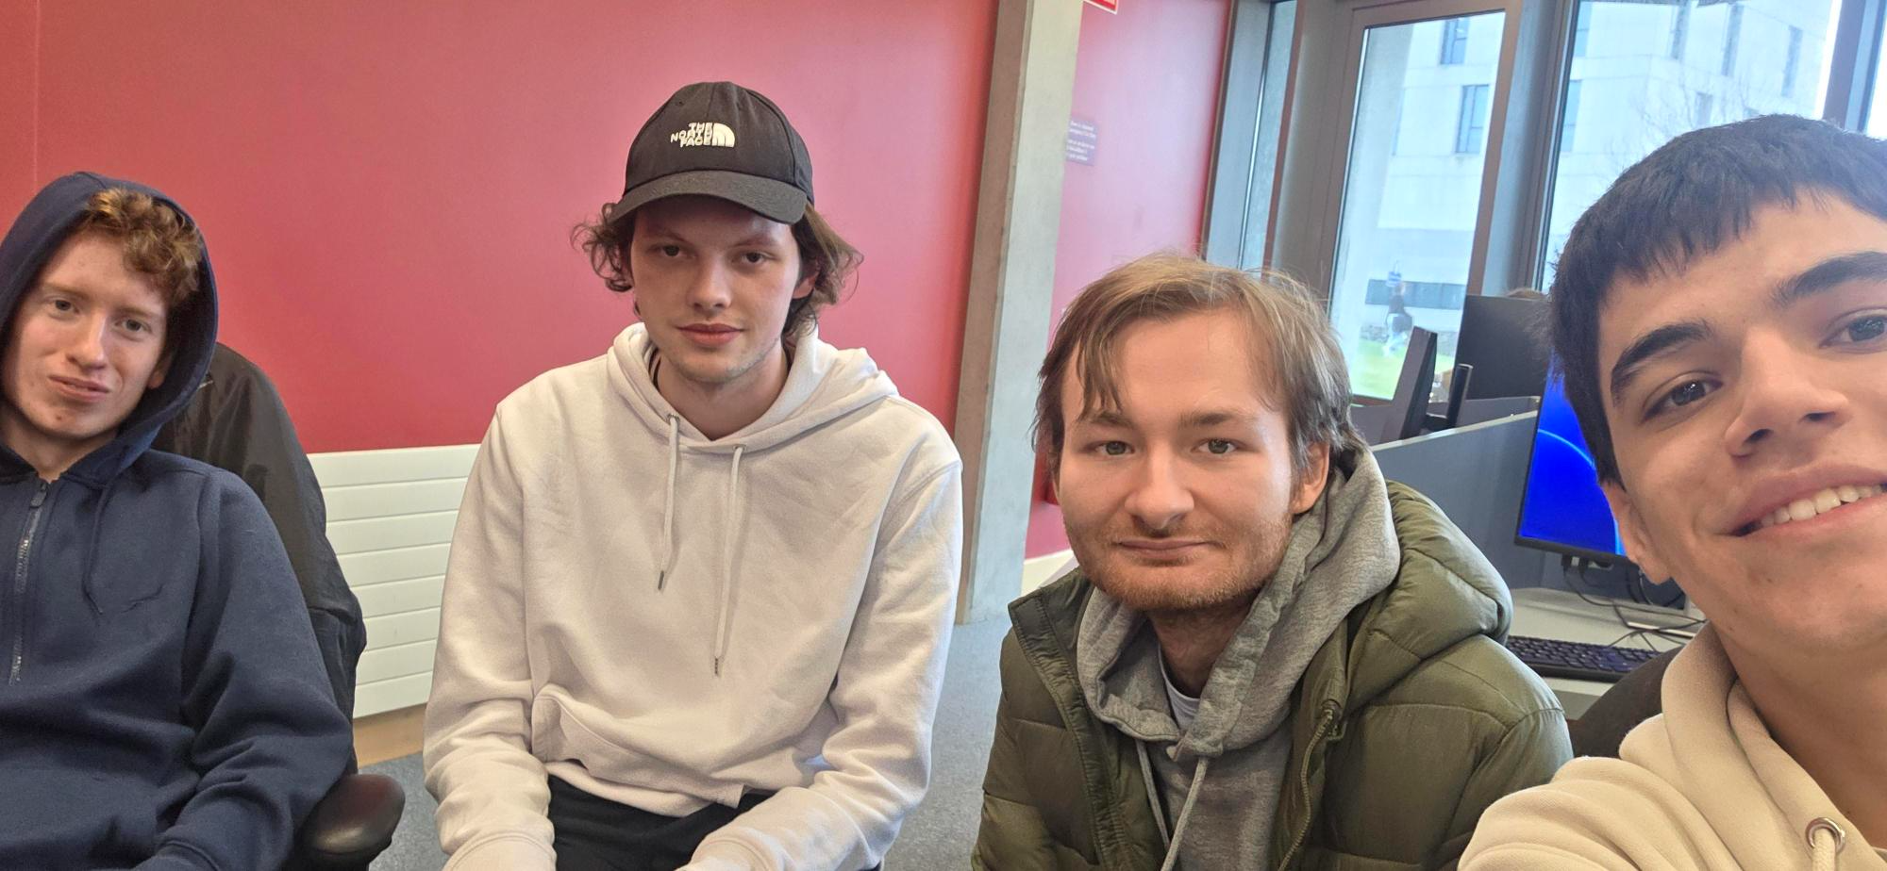
Team Members
Niall Concannon - Product Owner
Kamil Ciemniejewski – Dev Ops
Marko Radojcic – Tester
Daniel Balcerzak – Scrum Master

Slide 3
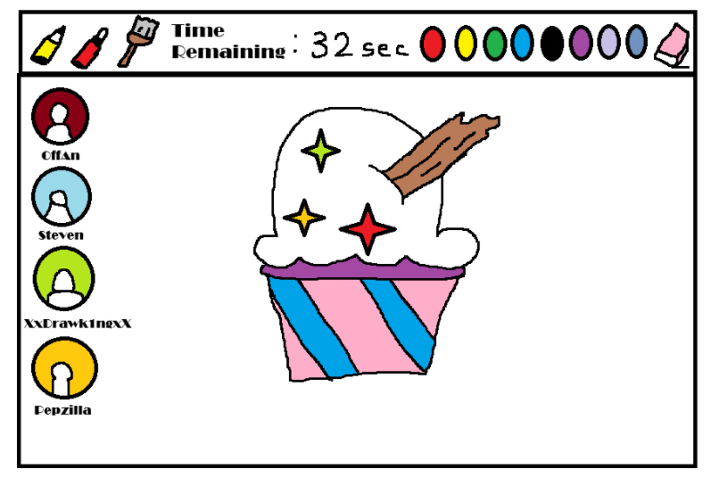
Project Description
Our Project revolves around a Drawing game for mobile.
The intention of the game is to see which person who
did the drawing best based ón the choosen prompt and
Determine the the number of votes to see who is the best
Out of all in the lobby.

Slide 4
Elevator Pitch
What is QuarckDraw even anyway? – Essentially its Drawing game app which allows multiple people to join in, draw and vote on who has the best drawing and the amount of votes.
What the big idea? - We want to thought that people need to expand and also be able to draw as fast as possible given that the task that they were given so that they can produce it within the time allocated
The solution – We wanted to create sort of game that allows the AI to choose which prompt it can come up and let the users draw with given tools and vote on whose drawing is the best out of all.
Call to Action – Essentially our objective is that we want the users to be able to share their creativity process and be able to show the capabilities on that work within a certain timeframe.

Slide 5
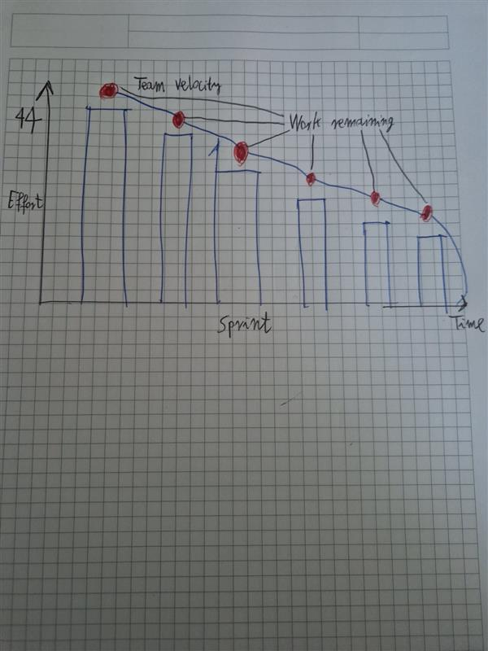
Burndown Chart

Slide 6
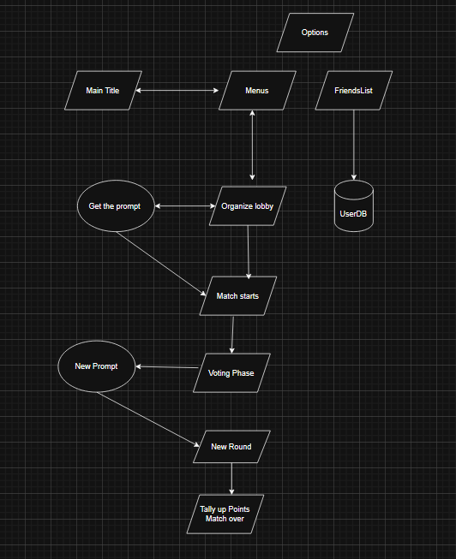
Architecture

Slide 7
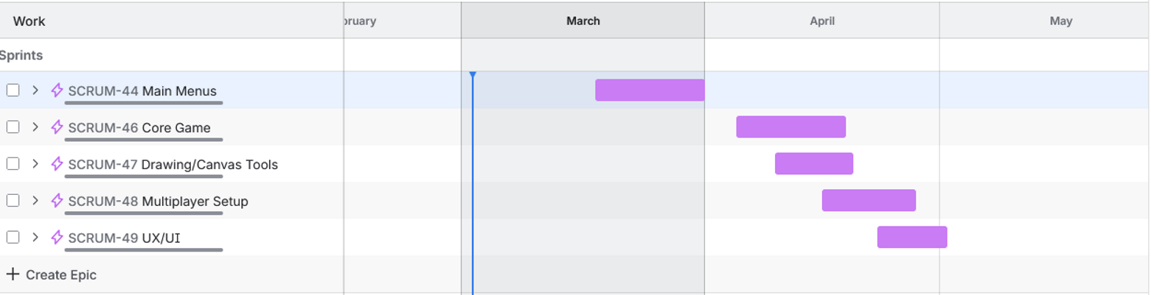
Product Roadmap

Slide 8
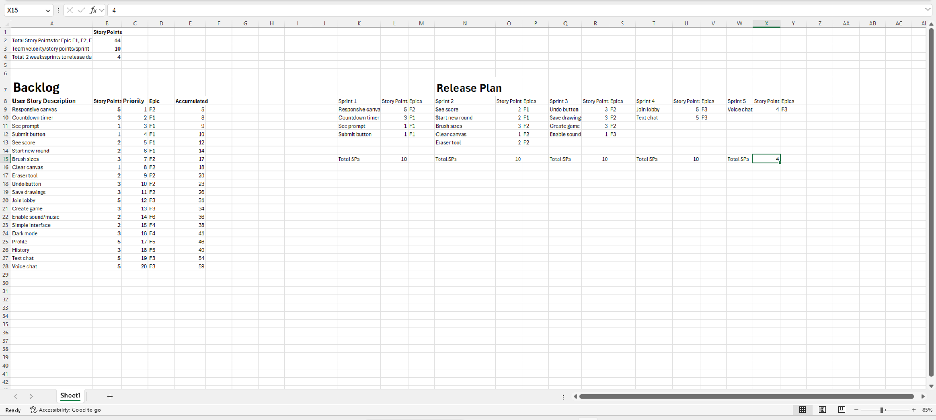
Release Plan

Slide 9
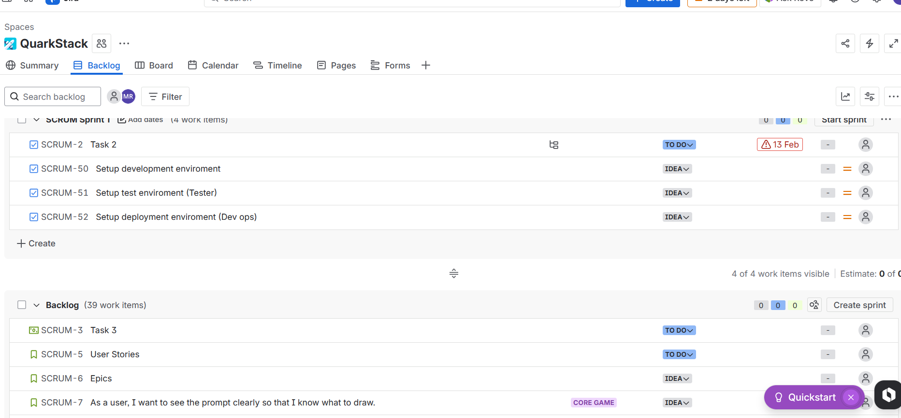
Jira Setup

Slide 10
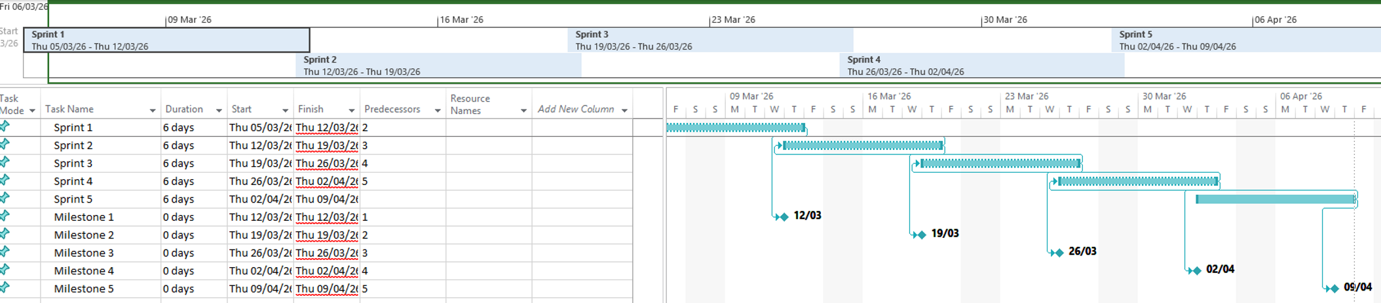
MS Project

